Slide 1
Smart Medicine Inventory
King Faisal Specialist Hospital & Research Centre · Supply Chain & Data Analytics
Drug tracking, demand forecasting and replenishment in one system
1,000
1.05M
9
973
medicines tracked
daily demand rows
forecasting models
medicines forecast
Hanin Alhazmi

Slide 2
Architecture
Next.js server
PostgreSQL
Browser
→
All SQL runs here
→
Real server via DATABASE_URL
Shows pages and charts only
9 models in lib/forecast.js
or embedded PGlite in pgdata
Never touches the database
Credentials stay protected
Same SQL in both modes
Import Excel pipeline
Upload file → validate → save to daily_demand → backtest 9 models → forecasts → dashboard refreshes by itself
Smart Medicine Inventory · 2

Slide 3
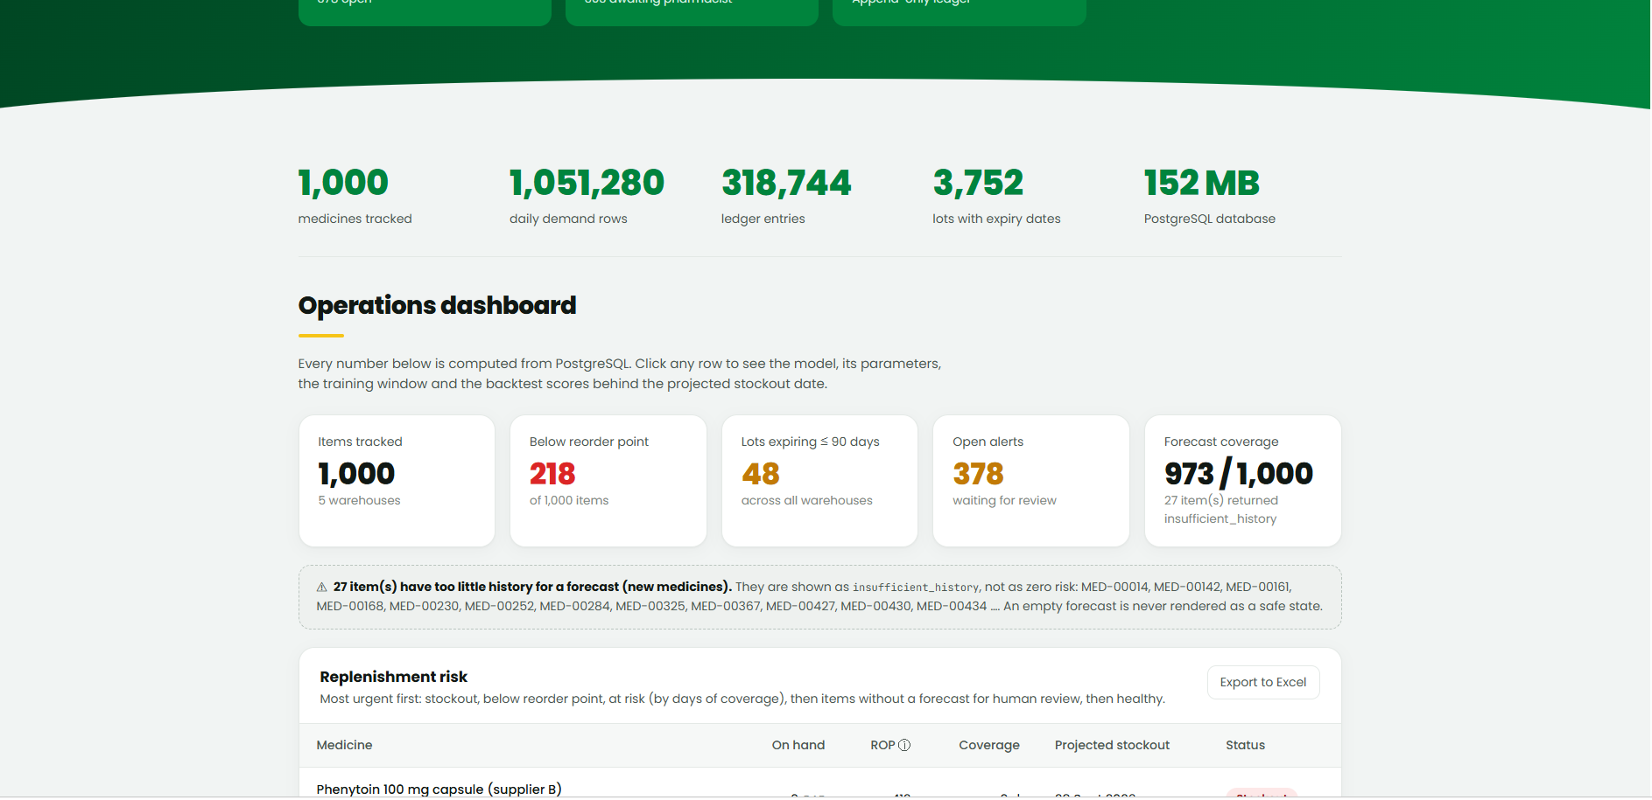
Operations dashboard
The first screen shows the whole inventory picture, computed live from PostgreSQL.
218 of 1,000 items below reorder point
378 open alerts, 48 lots expiring within 90 days
Forecast coverage 973 of 1,000; 27 new medicines flagged
Replenishment risk table, most urgent first
Smart Medicine Inventory · 3

Slide 4
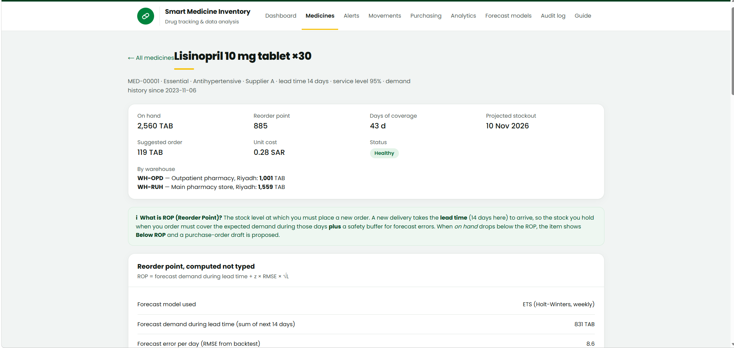
Medicine detail
One medicine in full: stock, reorder point and the reasoning behind every number.
On hand, days of coverage, projected stockout date
Reorder point = lead-time demand + z × RMSE × √L
Suggested order and stock by warehouse
Shows the forecast model used and its error
Smart Medicine Inventory · 4

Slide 5
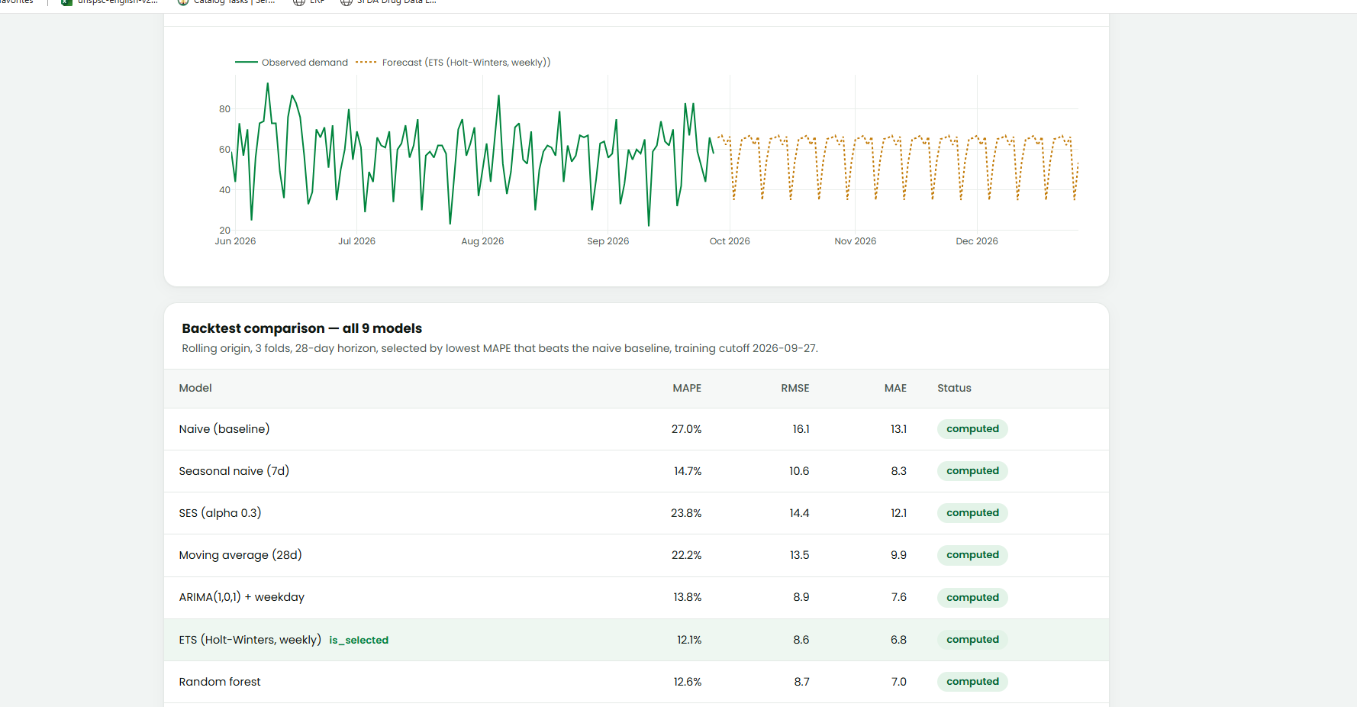
Forecast models
Observed demand against the 90-day forecast, plus the backtest of all 9 models.
Rolling origin, 3 folds, 28-day horizon
MAPE, RMSE and MAE for every model
Lowest MAPE that beats Naive is selected
Example: ETS wins with 12.1% MAPE
Smart Medicine Inventory · 5

Slide 6
How the best model is selected
1
2
3
Last 365 days
Hide and predict
Repeat 3 times
Fewer than 120 days: no forecast, marked insufficient_history, never shown as safe.
Hide the last 28 days, train on the rest, predict them and compare with reality.
Three folds from different starting points, so no model wins by luck.
4
5
6
Score with 3 metrics
Lowest MAPE beating Naive
Recompute and store
MAPE, RMSE and MAE for every model and every medicine.
If none beats Naive, keep Naive. The winner is flagged is_selected.
Save the 90-day forecast, then refresh ROP, coverage, alerts and PO drafts.
Smart Medicine Inventory · 6

Slide 7
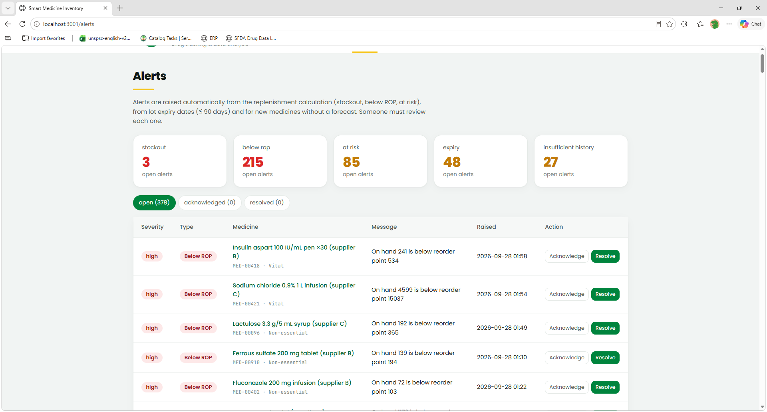
Alerts
Alerts are raised automatically and someone must review each one.
Stockout 3, below ROP 215, at risk 85
Expiry 48, insufficient history 27
Open, acknowledged and resolved views
Acknowledge or resolve with one click
Smart Medicine Inventory · 7

Slide 8
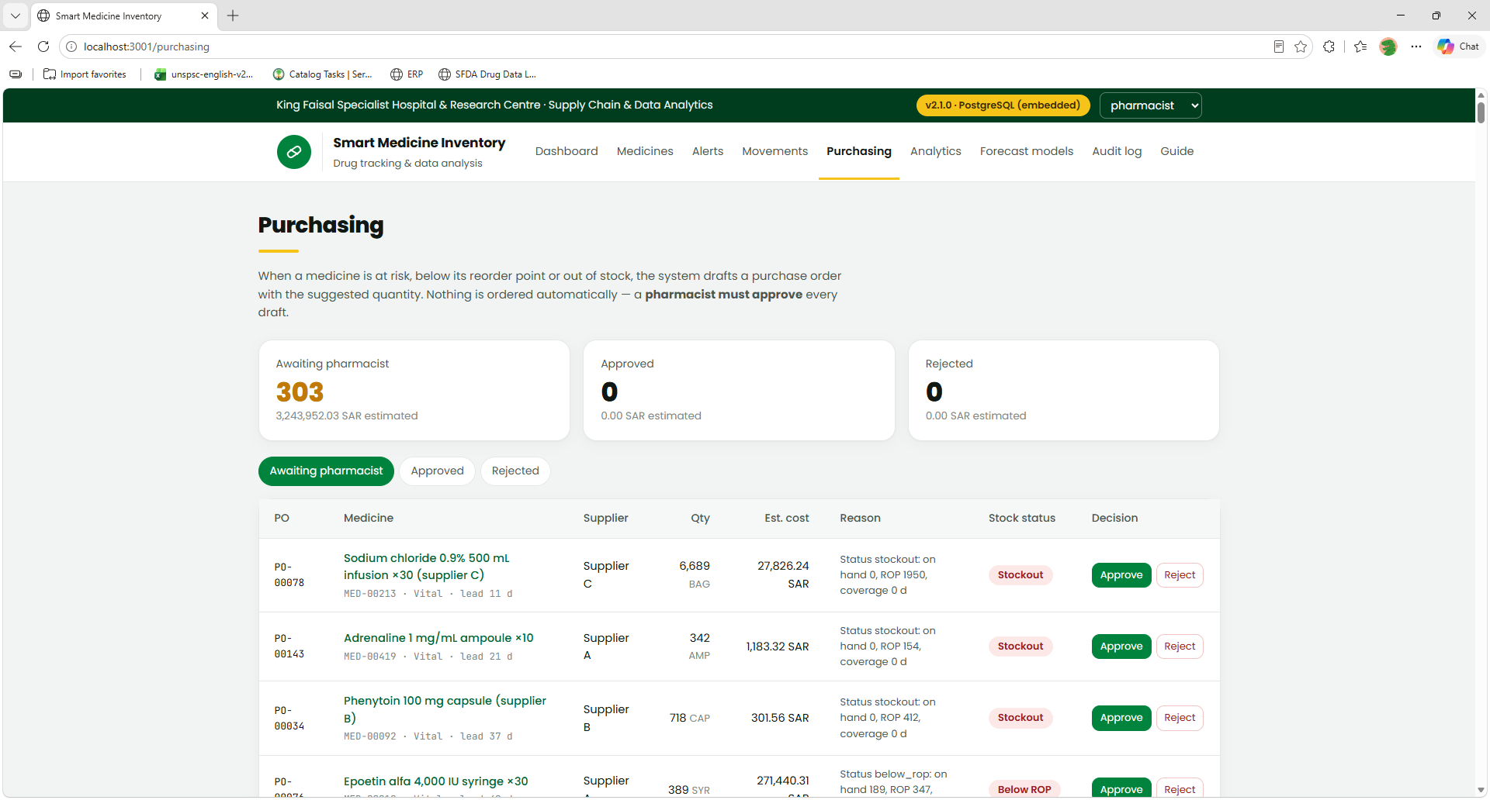
Purchasing
The system drafts purchase orders, but nothing is ordered without a pharmacist.
303 drafts awaiting approval, 3.24M SAR estimated
Suggested quantity, supplier and estimated cost
Reason shown for every draft
Approve or reject each order
Smart Medicine Inventory · 8

Slide 9
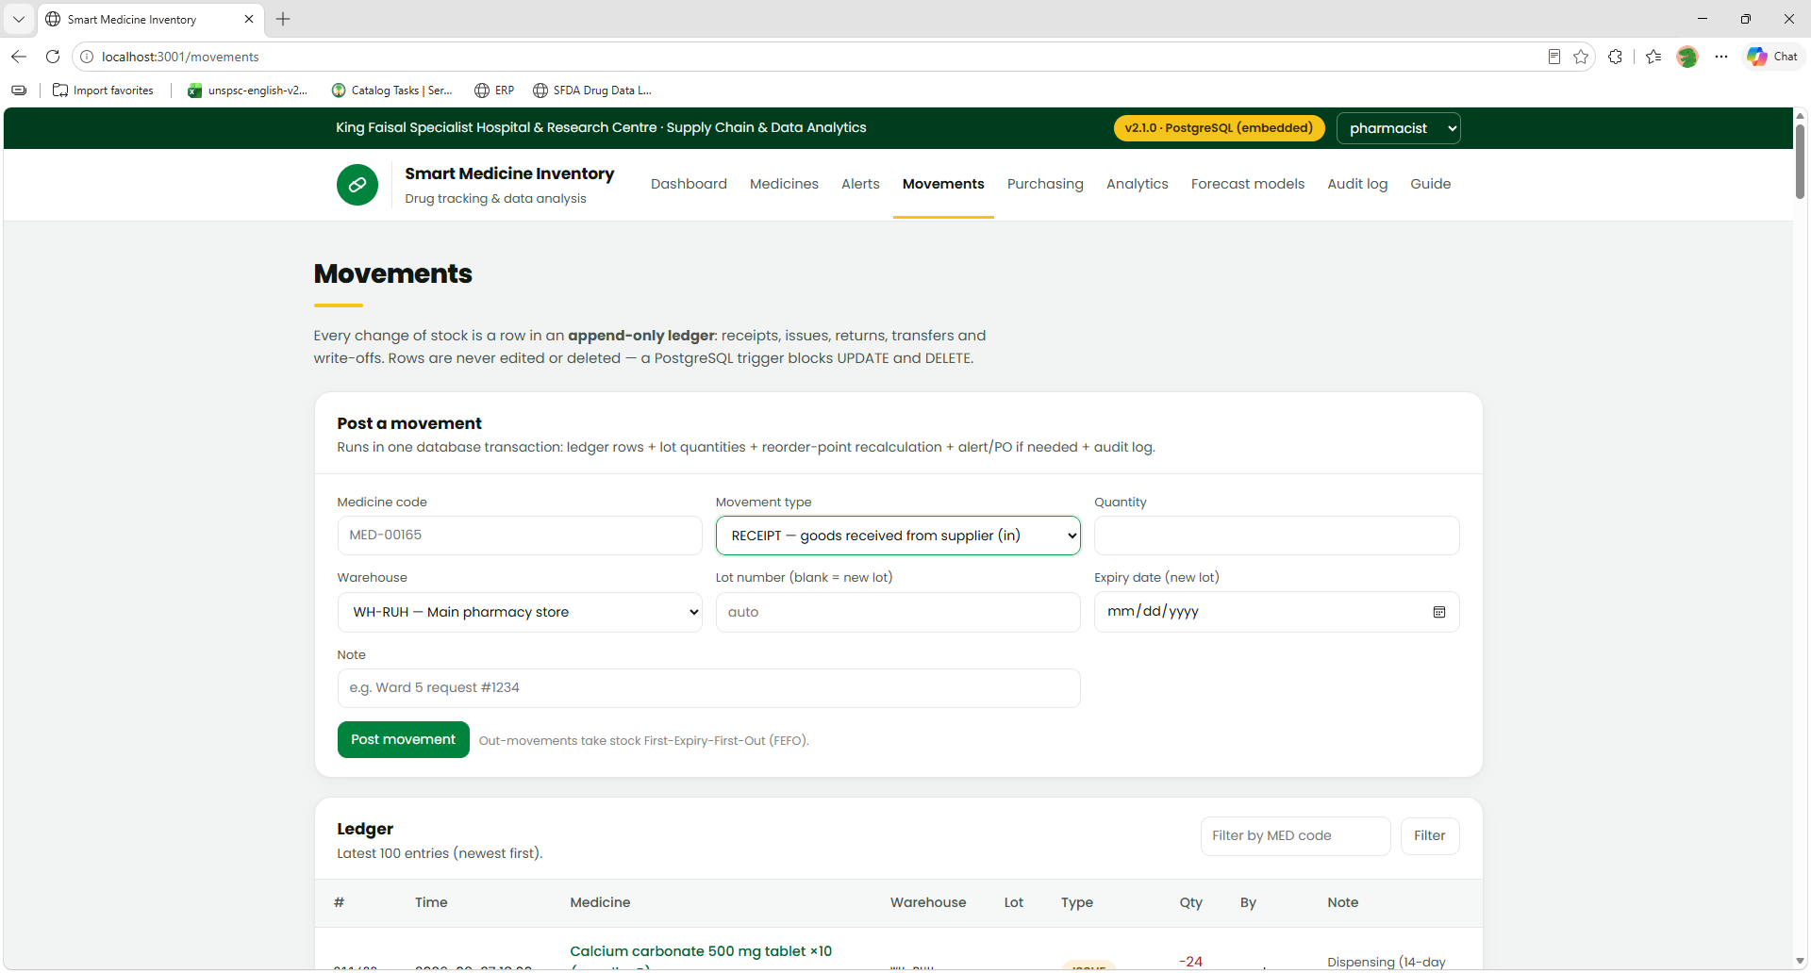
Movements
Every stock change is a row in an append-only ledger that can never be edited.
A PostgreSQL trigger blocks UPDATE and DELETE
Receipts, issues, returns, transfers, write-offs
One transaction updates ledger, lots, ROP and audit log
Out-movements follow first-expiry-first-out
Smart Medicine Inventory · 9

Slide 10
Live demo
Smart Medicine Inventory · 10

